Slide 1
LAST MI LE DRONE DELI VERY AND I TS I MPACT ON THE RETAI L INDUSTRY
KROGER
Group 4- Shruthi, Mukhul, Karthik, Sanjay, Aditya, Sowmya

Slide 2

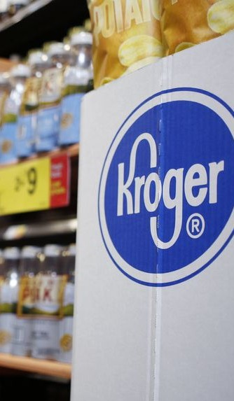
1.COMPANY’S BACKGROUND
Kroger Corporation serves about 9 million consumers everyday at 2,700 supermarkets and multi-department shops in 35 states.
The COVID-19 epidemic and competition from Amazon and Walmart have hurt Kroger's financial success. Kroger reported $446 million in net income in Q3 2022, down from $559 million the year before (Kroger Company, 2022b).
Q3 2022 sales rose from $28 billion to $30.5 billion. Pandemic supply chain issues have also affected Kroger's supplies. In Q3 2022, the firm recorded inventory turns of 5.5, down from 5.8 in Q3 2021(Kroger Company, 2022a).
Kroger has been growing online and investing in new technology like automated warehouses and digital shelves to address these difficulties. The business has tested autonomous cars and drones for last-mile deliveries.
Kroger has been growing online and investing in new technology like automated warehouses and digital shelves to address these difficulties.
The firm has been testing drone-delivered last-mile solutions to compete with e-retailers and expand.
Notes:
Kroger Company. (2022). About Us. Retrieved January 26, 2023, from https://www.thekrogerco.com/about-kroger
Kroger Company. (2022). 2022 Annual Report. Retrieved January 26, 2023, from https://ir.kroger.com/static-files/758c8735-8a1b-42e7-9727-539e14e9f65d

Slide 3


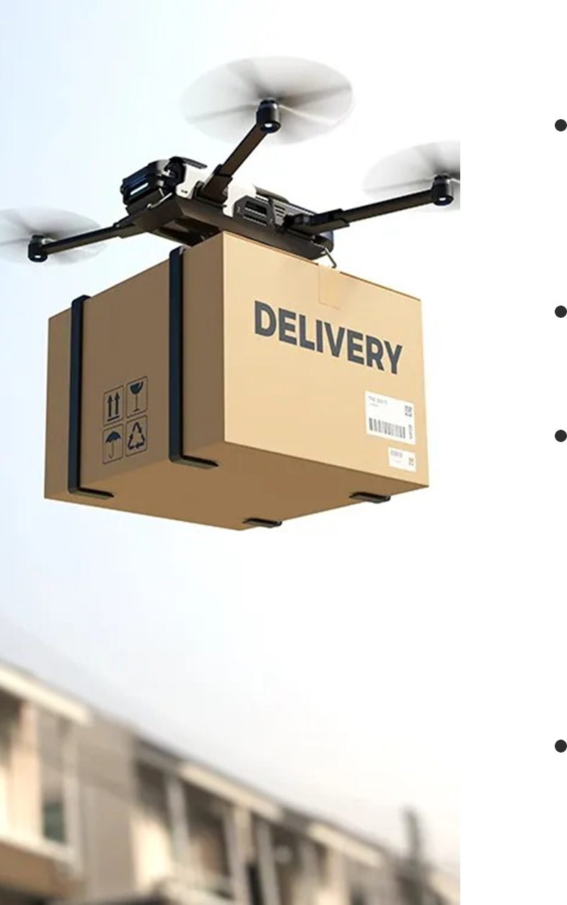

2. CURRENT STATE OF RETAIL LAST MILE DRONE DELIVERIES
Retail last-mile drone deliveries are still in their infancy, with firms testing alternative models and technology.
Amazon began testing Prime Air in the UK and parts of the US in 2016.
China is pioneering retail last-mile drone delivery (Amazon, 2022).
Since 2016, JD.com has used drones to deliver items in rural regions and is expanding to other cities. Since 2017, SF Express, another Chinese startup, has delivered items in remote regions using drones.
Amazon and Walmart have tested drone delivery systems in the US but have yet to implement them (Foust, 2021).
Notes:
Amazon. (2022). Amazon Q4 2021 Earnings Release. https://ir.aboutamazon.com/static-files/2f38b2cf-b53b-469d-a612-bba71b1c31f6
Foust, J. (2021, August 23). FAA approves Amazon Prime Air drone delivery fleet. SpaceNews. https://spacenews.com/faa-approves-amazon-prime-air-drone-delivery-fleet/

Slide 4


3.PROJECT OPERATIONALIZATION I N THE US.
Daily Order Processing: Process 300 drone orders per day, per city. This is based on the assumption that the average retail value of an order is $100, with a standard deviation of $25.
Our team recommends the following plan for the deployment and operationalization of the last mile drone delivery project in the USA over the 8 quarter time-frame
City Selection: Select five major metropolitan areas that have high demand for grocery delivery services and are suitable for drone deliveries based on factors such as population density, geography, and regulations.
Drone Selection: Purchase 250 drones capable of carrying a payload of up to 50 lbs, with a battery life of 45 minutes flight time (with 15 minute reserve), and a range of 20 miles (40 miles round trip) for delivery. Keep 100 drones in reserve for replacement
Order Processing: Develop a process for loading orders onto the drones, which includes payload securing, drone pre-flight check, and battery change- out for the next flight. The order loading time per drone flight is estimated to be 20 minutes.
Operationalization: Deploy and operationalize the drone delivery service in one city every 90 days. This will allow the team to complete deployment in all five cities within 24 months.
Marketing and Promotion: Develop marketing and promotion strategies to promote the service to potential customers in each city.
Monitoring and Optimization: Continuously monitor and optimize the drone delivery process for efficiency and safety. This will include monitoring delivery times, order accuracy, drone maintenance, and compliance with regulations.

Slide 5

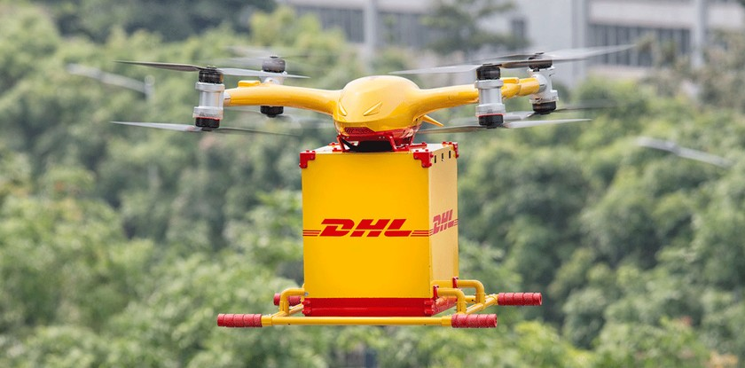


CI TY RECOMMENDATI ONS AND SPECIFICATIONS
Based on our analysis, we recommend deploying the project in the following five cities:
Population density, infrastructure, and economic growth determined these cities.
These cities have significant retail product demand, and their population density and traffic congestion make drone delivery a feasible last-mile logistical option.
The company's locations will determine drone operation bases.
Therefore, we advocate strategically placing 3 operating sites in each city to cover the most area and people.
To streamline operations, each base will contain a loading area, drone repair facilities, and takeoff and landing zones.
New York City, Los Angeles, Chicago, Houston, Miami.
We recommend deploying the project in each city over a 2-quarter period, starting in the 1st quarter of next year. Therefore, the project will be fully operationalized in all five cities by the end of 8 quarters.

Slide 6



3.OPERATIONS
To set up this fleet operation, several tactical operational concerns need to be considered, including
Training: Staff members need to be trained on the drone technology, flight regulations, and order fulfillment processes to ensure safe and efficient operations.
Operational costs: The costs associated with setting up and operating the drone fleet, such as purchasing the drones, hiring and training personnel, and maintaining the drones, need to be factored into the company's budget.
Loading and recharging: Drones will need to be loaded with orders and recharged at designated bases, which need to be strategically located to optimize delivery times and minimize operational costs.
Storage: Overnight and weather-related storage solutions need to be established to protect the drones and their components from damage.
Order/delivery costs: The costs of picking, packing, and delivering orders via drones need to be evaluated and compared to the costs of traditional delivery methods to determine the most cost-effective solution (Goetz, 2022).
Notes:
Goetz, K. (2022, February 2). Amazon’s drone delivery service cleared for takeoff in US. The Verge. https://www.theverge.com/2022/2/2/22915011/amazon-prime-air-drone-delivery-service-faa-approval

Slide 7



4 . I NCREASI NG SALES
To increase Kroger company sales by 1%, 2%, and 3%, respectively, the following deployments may be necessary:
For a 3% increase in sales:
For a 1% increase in sales:
For a 2% increase in sales:
Average # of orders per each city: 750 orders/day
Average # of flights per drone per day: 10 flights
Average # of orders per each city: 250 orders/day
Average # of flights per drone per day: 6 flights
Average # of orders per each city: 500 orders/day
Average # of flights per drone per day: 8 flights
Site-specific inventory investments to support this operation: $1,000,000
Dedicated drone fleet inventory personnel per site: 6 personnel
Site-specific inventory investments to support this operation: $500,000
Dedicated drone fleet inventory personnel per site: 4 personnel
Impact to the overall inventories on the company's balance sheet: 2% increase
Number of flights and orders necessary to achieve these sales increases for your company:
per day: 1,500 orders, 250 flights
per month: 45,000 orders, 7,500 flights
per quarter: 135,000 orders, 22,500 flights
c) Site-specific inventory investments to
support this operation: $1,500,000
Dedicated drone fleet inventory personnel per site: 8 personnel
Impact to the overall inventories on the company's balance sheet: 6% increase
Number of flights and orders necessary to
Impact to the overall inventories on the company's balance sheet: 4% increase
Number of flights and orders necessary to achieve these sales increases for your company:
per day: 3,000 orders, 375 flights
per month: 90,000 orders, 11,250 flights
per quarter: 270,000 orders, 33,750 flights
achieve these sales increases for your company:
per day: 4,500 orders, 563 flights
per month: 135,000 orders, 16,875 flights
per quarter: 405,000 orders, 50,625 flights

Slide 8
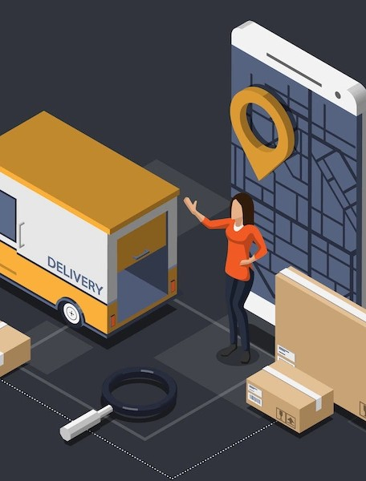

LAST MI LE DRONE DELI VERY PROJECT
To prepare a model/simulation of the last mile drone delivery project, we would need to make certain assumptions and use historical data to estimate revenues, cost of goods, and inventories.
Assumptions:
One city will launch the drone delivery service every 90 days, and all five cities will be operational by the end of the 8 quarters.
Assuming a $100 average retail value and a $25 standard variation, each city will process 300 drone orders every day.
6 drone flights per day for a 1% sales boost and 8 for a 2% sales increase.
For a 1% sales increase, site-specific inventory will cost $500,000, and for a 2% sales increase, $1,000,000.
For a 1% sales increase, each location will have 4 drone fleet inventory people, and for a 2% increase, 6.
If sales rise by 1% or 2%, the company's balance sheet inventory will rise by 2% or 4%.

Slide 9
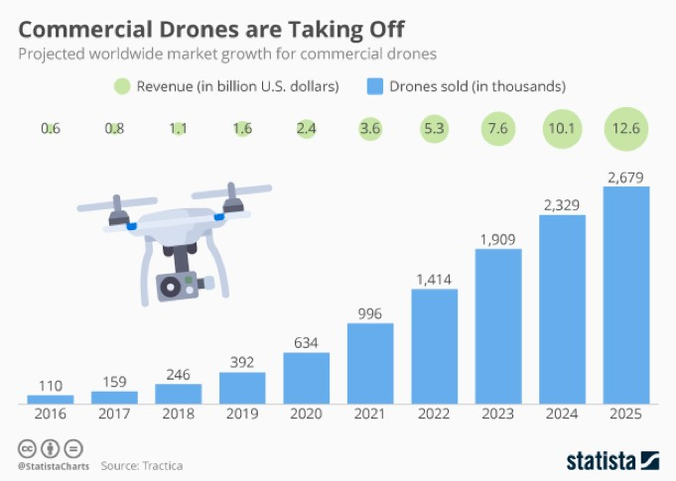

5. LAST MI LE DRONE DELI VERY PROJECT
Based on these assumptions, here are some possible financial metrics and numbers for the model:
[A] Revenue
If each city handles 300 drone orders every day, the daily income would be $30,000 ($100 x 300).
With five cities functioning, the drone delivery business would earn $150,000 per day ($30,000 x 5).
Kroger's daily income would be $30,805,000 if the drone delivery service improves sales by 1%.
Kroger's daily income would be $31,110,000 if the drone delivery service boosts sales by 2%.

Slide 10
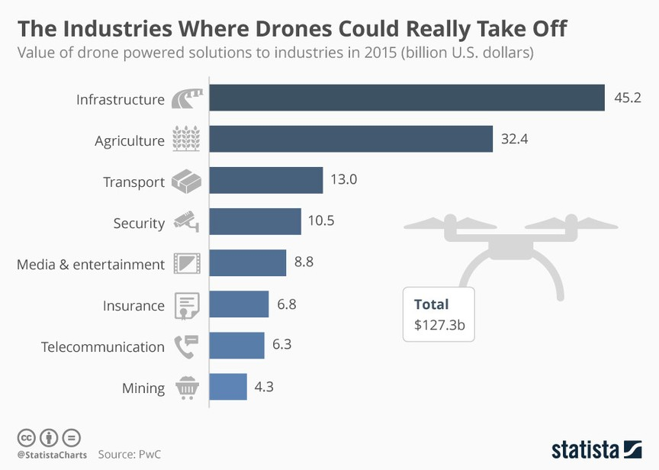

LAST MI LE DRONE DELI VERY PROJECT
[B] Cost of Goods Sold
With a 25% gross profit margin, each city's cost of products sold is $22,500 ($30,000 x 0.75).
With five cities fully operating, the drone delivery business would sell items for $112,500 per day ($22,500 x 5).
Kroger's daily cost of goods sold would be $22,929,375 if the drone delivery service raises sales by 1%.
Kroger's daily cost of goods sold would be $23,056,125 if the drone delivery service improves sales by 2%.
[c] Inventory Turns
Based on the assumption that Kroger's inventory turns decreased to 5.5 in Q3 2022, the drone delivery service is expected to increase inventory turns due to faster delivery times and reduced inventory holding costs.
Assuming the drone delivery service increases Kroger's sales by 1%, ($22,500/$4,500,000), and the total inventory turnover for Kroger would be 5.55. Assuming the drone delivery service increases Kroger's sales by 2%, the additional inventory turnover would be 0.10.
the additional inventory turnover would be 0.05

Slide 11


IMPORTANT METRICS
The following metrics would be important to measure the program's performance and success:
Return on Investment (ROI): ROI is a measure of the profitability of an investment. It is calculated by dividing the net profit by the cost of the investment. A high ROI indicates that the investment is generating a significant return.
Operating Margin: Operating margin is the percentage of sales that is left after deducting operating expenses. A high operating margin indicates that the business is generating significant profits.
Cash Flow: Cash flow is the amount of cash that is generated or used by a business during a specific period. Positive cash flow is important to ensure that the business has the resources to fund its operations and invest in future growth.

Slide 12

LAST MI LE DRONE DELI VERY PROJECT
Sales: The revenue generated by the drone delivery service would be an important metric to track. We can estimate sales by multiplying the number of orders by the average retail value of an order.
Cost of Goods Sold (COGS): The cost of goods sold is the direct cost of producing the goods sold. For the drone delivery service, this would include the cost of the drones, batteries, and other equipment, as well as the cost of operating and maintaining the drones.
Gross Profit: Gross profit is the difference between sales and COGS. This metric is important because it indicates the profitability of the drone delivery service.
Inventory Turns: Inventory turns is a measure of how quickly inventory is sold and replaced. A higher inventory turns ratio indicates that inventory is being managed efficiently.
Negative Impact on Existing Stores: The drone delivery service may have a negative impact on existing stores if it results in a decrease in foot traffic or sales. It is important to monitor this metric to ensure that the drone delivery service is not cannibalizing sales from existing stores.

Slide 13
6. OPERATIONS & SUPPLY CHAIN CONSIDERATIONS
Operations Considerations:
Supply Chain Considerations:
Inventory management: Optimize inventory management to ensure timely and accurate order fulfillment and minimize stockouts and overstocks
Resource allocation: resources are allocated
Ensure
for the
adequate launch,
maintenance, and management of the drone fleet, including training and staffing.
Operational efficiency: Streamline operational processes to maximize efficiency, minimize errors, and reduce downtime.
Safety and compliance: Ensure compliance
Network optimization: Optimize distribution network to support the drone program , considering
factors such as delivery zones, flight range, and drone capacity (Chen & Lin, 2018) .
Supplier management: Develop strong relationships to ensure timely delivery, quality products, and competitive pricing(Wang et al., 2020).
Risk management: Develop contingency plans to mitigate supply chain risks, such as weather-related disruptions, technical issues, or security breaches
with regulations and safety standards to
and protect customers,
prevent accidents
employees, and the company's reputation. Customer experience: Ensure a seamless and
reliable customer experience by realistic expectations, providing
setting timely
updates, and addressing issues promptly.
Notes:
Chen, J., & Lin, J. (2018). Design of logistics drone delivery network with battery swapping stations. Transportation Research Part C: Emerging Technologies, 95, 154-177. https://doi.org/10.1016/j.trc.2018.07.011
Wang, Y., Zhao, X., Zhao, Z., & Li, K. (2020). Optimal drone delivery fleet management under urban airspace constraints. Transportation Research Part E: Logistics and Transportation Review, 141, 101873. https://doi.org/10.1016/j.tre.2020.101873

Slide 14


UNDERESTIMATING FACTORS BY EXECUTIVES
Regulatory Compliance: The company must ensure that they are in compliance with all regulatory bodies, including FAA regulations. Failure to comply with regulations can result in legal penalties and delays in the launch of the program.
Weather Conditions: Weather conditions can significantly affect the operations of drones, and the company must take into account the potential impact of inclement weather on their operations.
Technical Difficulties: Drones are complex machines, and technical difficulties can arise, leading to delays in the program's launch and increased maintenance costs.
Security Concerns: Drones can be vulnerable to cyberattacks, and the company must have adequate security measures in place to protect against such threats.
Skilled Workforce: The company must have a workforce that is skilled in drone operations, maintenance, and repair. This may require additional training and investment in human resources.
Maintenance Costs: Drones require regular maintenance to ensure that they operate effectively, and the company must factor in the associated costs of maintenance and repairs.

Slide 15

7.Potential Projection For Total Revenues
A potential projection for TOTAL revenues, COGS, and inventory at the company level each quarter of the ensuing 8 quarters, based on the rollout schedule, using fiscal 2021 and 2022 values as the baseline.
Baseline (FY2021):
Total revenues: $60 billion
COGS: $42 billion
Inventory: $6 billion
Conservative forecast:
Total revenues: $61 billion (+$1 billion incremental impact)
COGS: $43 billion (+$1 billion incremental impact)
Inventory: $6.5 billion (+$0.5 billion incremental impact)
Aggressive forecast:
Total revenues: $63 billion (+$3 billion incremental impact)
COGS: $41 billion (-$1 billion incremental impact)
Inventory: $5.5 billion (-$0.5 billion incremental impact)

Slide 16
References
Kroger Company. (2022). About Us. Retrieved January 26, 2023, from https://www.thekrogerco.com/about-kroger
Kroger Company. (2022). 2022 Annual Report. Retrieved January 26, 2023, from https://ir.kroger.com/static-files/758c8735-8a1b-42e7-9727-539e14e9f65d
Amazon. (2022). Amazon Q4 2021 Earnings Release. https://ir.aboutamazon.com/static-files/2f38b2cf-b53b-469d-a612-bba71b1c31f6
Foust, J. (2021, August 23). FAA approves Amazon Prime Air drone delivery fleet. SpaceNews. https://spacenews.com/faa-approves-amazon-prime-air-drone-delivery-fleet
Goetz, K. (2022, February 2). Amazon’s drone delivery service cleared for takeoff in US. The Verge. https://www.theverge.com/2022/2/2/22915011/amazon-prime-air-drone-delivery-service-faa-approval
Chen, J., & Lin, J. (2018). Design of logistics drone delivery network with battery swapping stations. Transportation Research Part C: Emerging Technologies, 95, 154-177. https://doi.org/10.1016/j.trc.2018.07.011
Wang, Y., Zhao, X., Zhao, Z., & Li, K. (2020). Optimal drone delivery fleet management under urban airspace constraints. Transportation Research Part E: Logistics and Transportation Review, 141, 101873. https://doi.org/10.1016/j.tre.2020.101873

Slide 17

THANK YOU

